Slide 1


How to Enhance that UI with PCF
Rami Mounla
Solution Architect | Power Platform | DXC NZ

Slide 2
You, Me, and the Power Platform

Slide 3
What is the Power Platform Component Framework?

Slide 4
Examples

Slide 5
Field v Data Sets

Slide 6
Learning Curve
What you need to know

Slide 7
Technologies
NPM
TypeScript
HTML + CSS

Slide 8


Slide 9
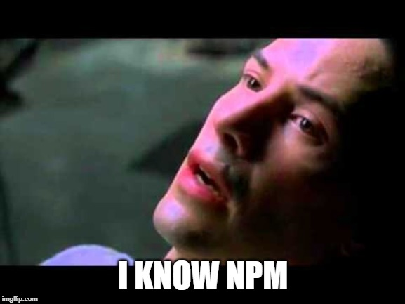

Slide 11
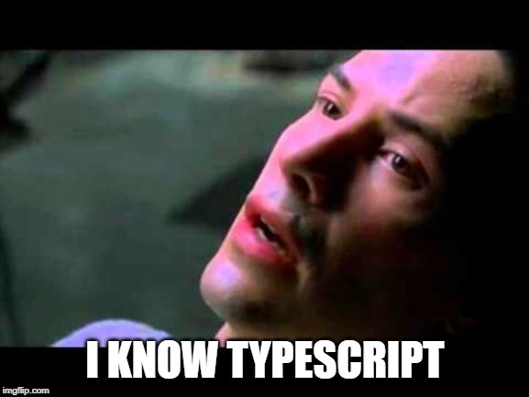

Slide 12
The 8 Commands
That you need to know

Slide 13
Cheat Sheet Create Control
pac pcf init --namespace XrmEnterprise --name CalendarView --template dataset
pac pcf init --namespace XrmEnterprise --name Tile --template field
npm install
npm run build
npm start

Slide 14
Cheat Sheet Package Control
pac solution init --publisher-name XrmEnterprise --publisher-prefix xe
pac solution add-reference --path ..\CalendarView
msbuild /t:restore
msbuild

Slide 16
Example: Field

Slide 17
Example: Data Set

Slide 20


Slide 21
Useful links
Microsoft Documentation
https://docs.microsoft.com/en-us/powerapps/developer/component-framework/overview
Rami’s Samples
https://github.com/ramimounla

Slide 22

Thank you

